Slide 1
NSFM Q2 2025 Communications Report
July 1, 2025

Slide 2
EXECUTIVE SUMMARY

Slide 3
EXECUTIVE SUMMARY
The second quarter of 2025 was marked by strong engagement and strategic initiatives across NSFM’s communications platforms.
Highlights include the Spring Conference held in Truro (April 30–May 2) and the launch of NSFM’s Lunch & Learn Series, featuring sessions on Trade Shifts and Economic Outlook (May) and Deer Governance (June). NSFM also released its 2024 Annual Report, the Spring/Summer Atlantic Municipal Magazine, and the Summer Municipal Observer.
The quarter saw a federal leadership change, with Mark Carney becoming Prime Minister at the end of April. NSFM also marked the completion of Municipal Code of Conduct Training. Four member surveys were launched: Board Evaluation, Potential Tariffs, Funding Navigation Feedback, and Stormwater Management Projects. The Board reviewed briefing materials on an updated land acknowledgement and NSFM’s transition away from X/Twitter to Bluesky.
Monthly funding updates continued, and a new interactive Google Map went into development in collaboration with immediac. Finally, NSFM posted two new positions: Environment & Climate Change Policy Advisor and Fund Navigator, expanding support for members.
This report provides an in-depth analysis of our communications performance, covering social media, the NSFM website, media coverage, and our eNewsletter, the Monday Memo.

Slide 4
SOCIAL CHANNELS

Slide 5
Social Media Definitions
Commonly used terms in Social Media Content Analysis:
Clicks: refer to the total number of times users clicked on any clickable element in your content. This includes not just links but also buttons, images, or other interactive features within the post. It gives a broader view of how often people are interacting with your content beyond just link clicks.
Reactions: The responses users give to a post, such as likes, loves, laughs, or other emoji reactions. This metric shows how people feel about the content.
Engagement Rate: The percentage of people who interact with your content (e.g., likes, comments, shares, clicks) compared to the total number of people who saw it. It measures how engaging or effective your content is.
Link Clicks: The number of times users clicked on a link in your post or content, leading them to another webpage or destination.
Reach: The total number of unique users who have seen your content at least once. It reflects how many different people your content is reaching.
Content Interactions: Any action users take on a post or piece of content, such as liking, commenting, sharing, or clicking. This measures overall activity or interaction with the content.
Impressions: The total number of times your content was displayed or shown on a screen, regardless of whether it was clicked or interacted with. This counts repeat views by the same person.

Slide 6
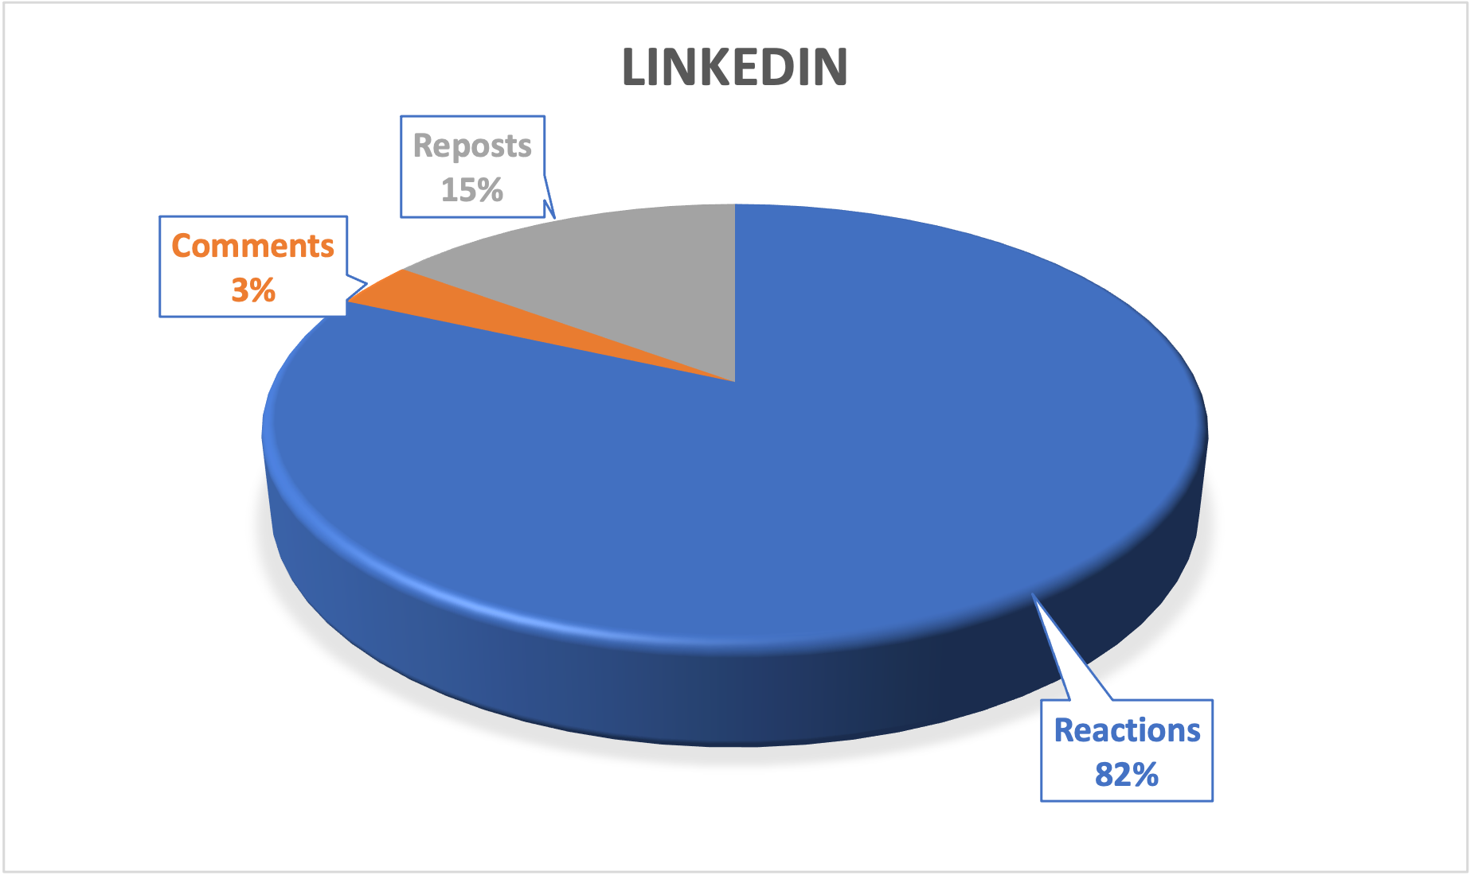

linkedin
Follower Growth – 6.60%
Apr. 1 – 1330
Jun. 30 – 1424
Engagement Rate = 10.39%

Slide 7




Top Performing Content
Clicks 54
Clicks 35
Clicks 25

Slide 8


FACEBOOK
Follower Growth 0.74%
Apr. 1 – 803
Jun. 30 – 809
Engagement Rate = 4.29%

Slide 9



Top Performing Content
Views 78
Views 71
Views 57

Slide 10
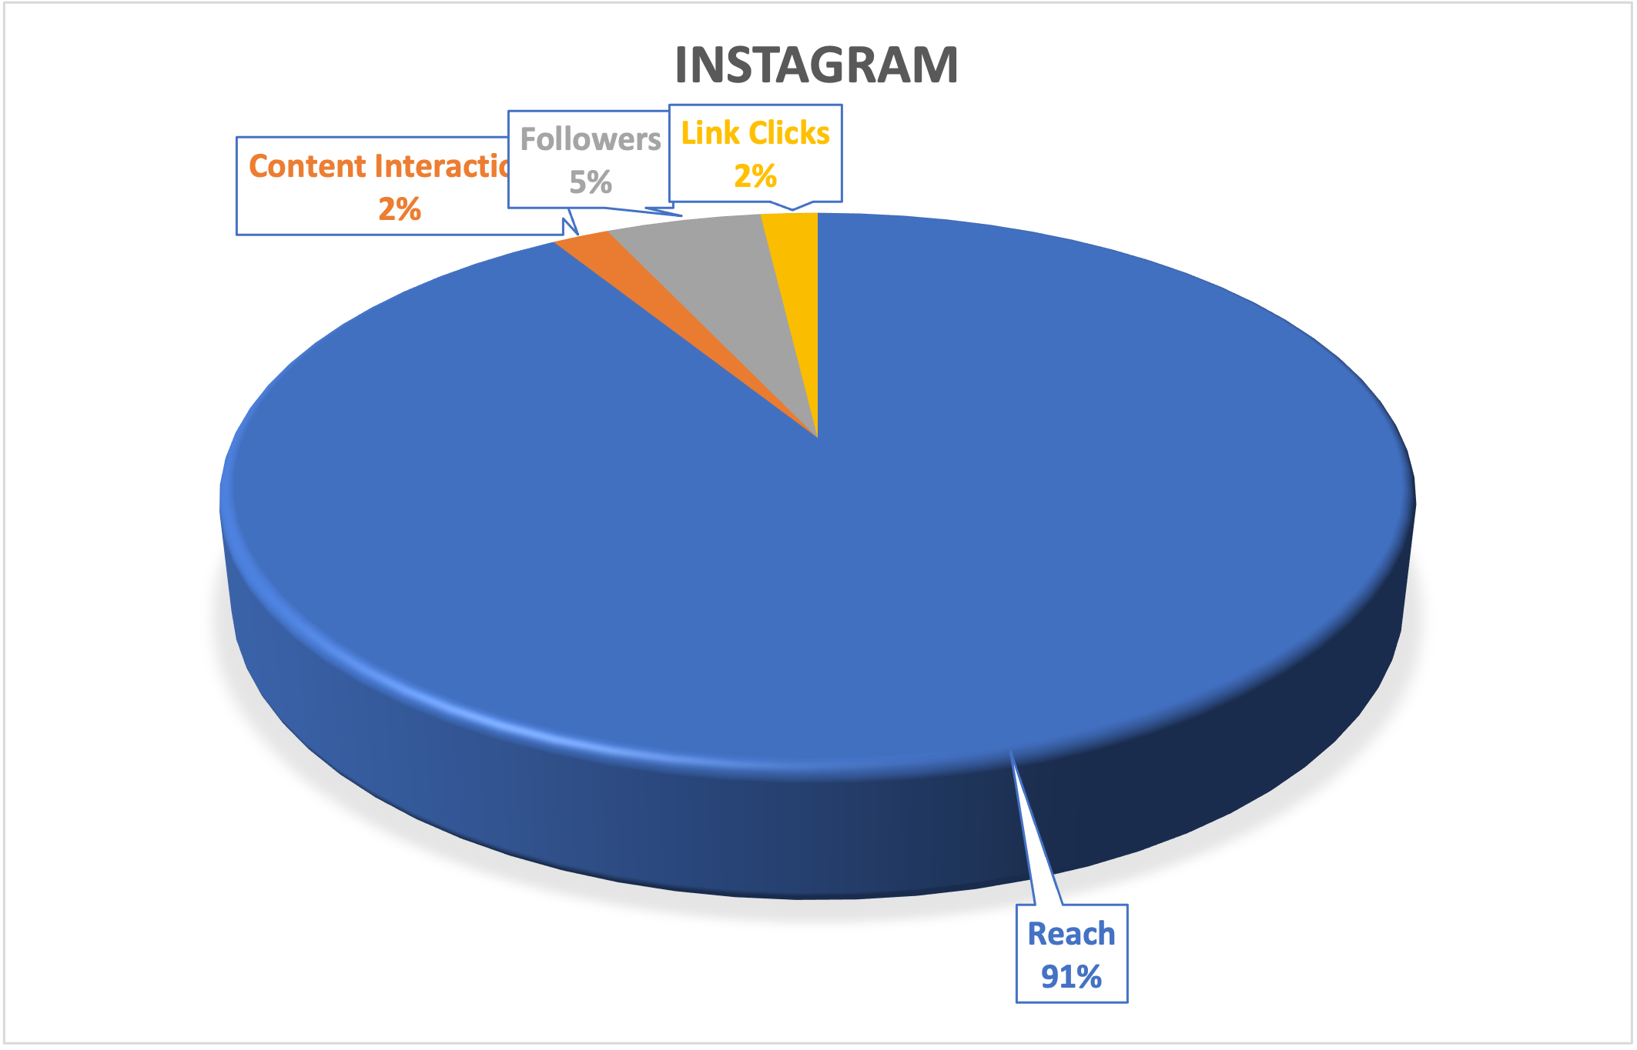

Instagram
Follower Growth 3.70%
Apr. 1 – 286
Jun. 30 – 297
Engagement Rate = 4.09%

Slide 11



Top Performing Content
Views 215
Views 183
Views 168

Slide 12


BLUESKY
Follower Growth 3.70%
Apr. 1 – 0
Jun. 30 – 27
Engagement Rate = 29.63%
NOTE: Joined May 12, 2025 - Bluesky hasn’t released native analytics tools yet, so data not available

Slide 13



Top Performing Content
Likes 2
Likes 1
Likes 1

Slide 14
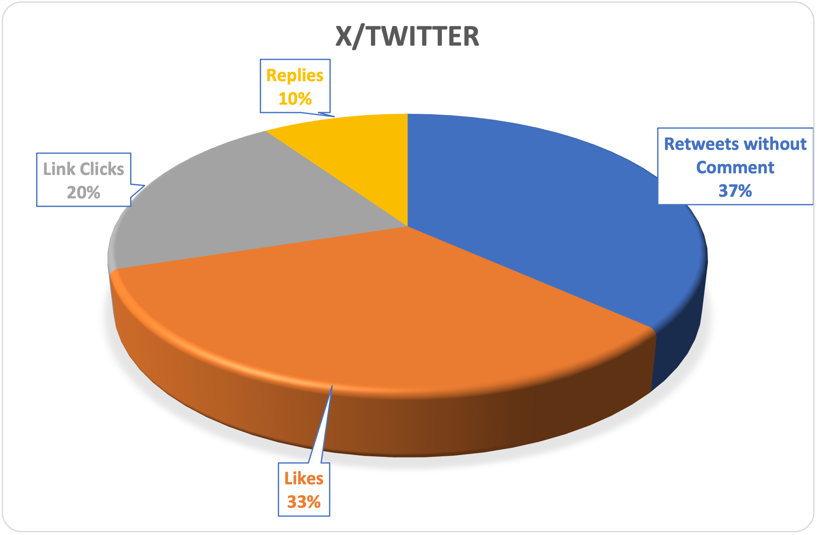

x/twitter
Follower Growth 0.37%
Apr. 1 – 1073
Jun. 30 – 1077
Engagement Rate = 1.57%

Slide 15



Top Performing Content
Views 742
Views 382
Views 320

Slide 16





Key Insights for Social Media
Bluesky - shows the highest engagement rate, but due to very limited audience size, it’s more of an experimental or emerging platform.
LinkedIn - is your most effective mainstream platform, showing both volume and engagement strength.
Facebook - is a traffic-driver, suggesting it works well for sharing links and driving action
X/Twitter - is underperforming and may need a re-evaluation of prioritization.
Instagram - Engagement is healthy

Slide 17
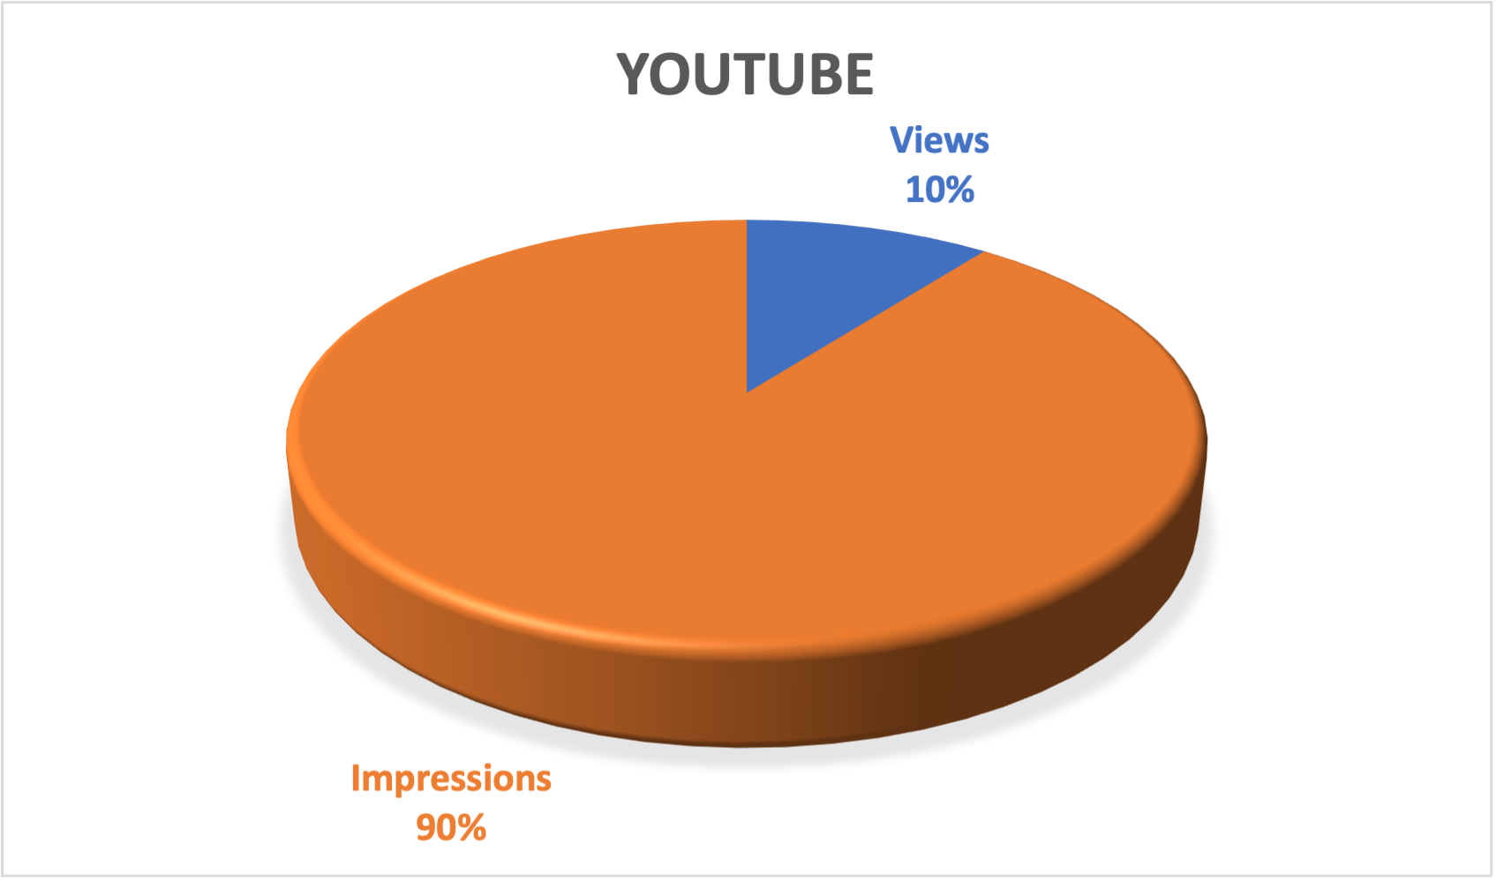

youtube

Slide 18
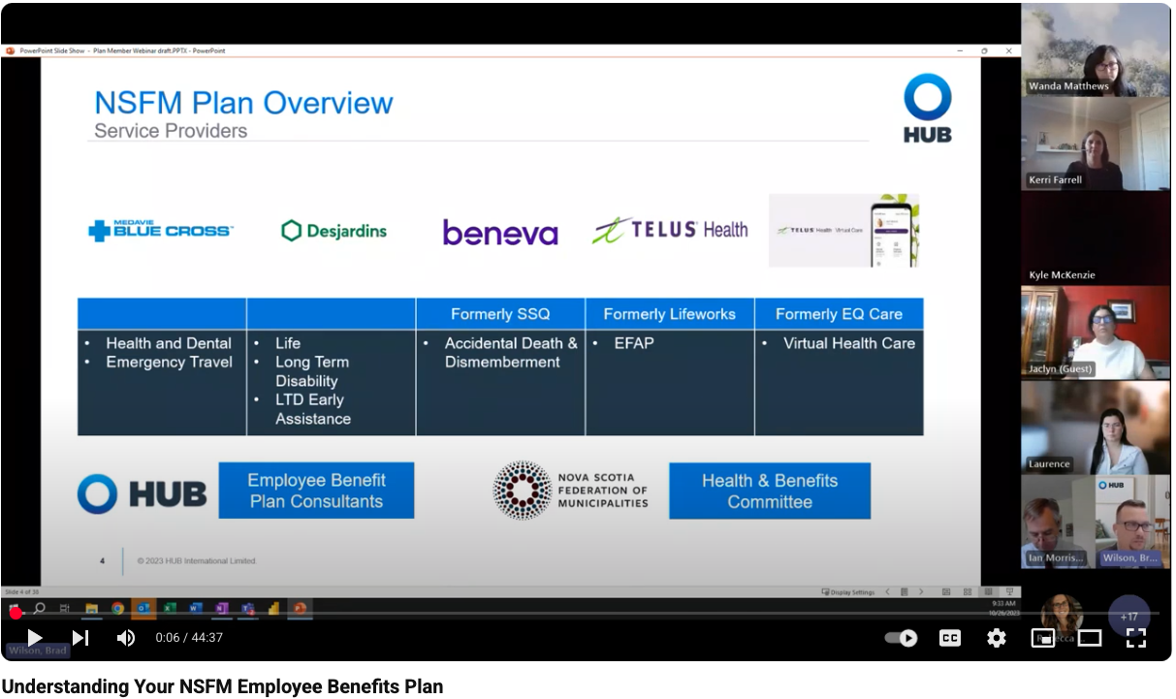


Top Performing Content
Views 22
Views 9
Views 9

Slide 19
NSFM Website

Slide 20
Online Definitions
Commonly used terms in Online Content Analysis:
Organic Search: Visitors who land on your website or content through unpaid search engine results, such as Google or Bing, without any paid ads.
Direct: Traffic that comes to your website directly, either by typing your URL into a browser or clicking on a saved bookmark.
Referral: Traffic that comes to your website from another site via a link, excluding social media or search engines.
Organic Social: Traffic or visitors that come to your website from unpaid, non-boosted posts on social media platforms (e.g., from regular posts, not ads).

Slide 21
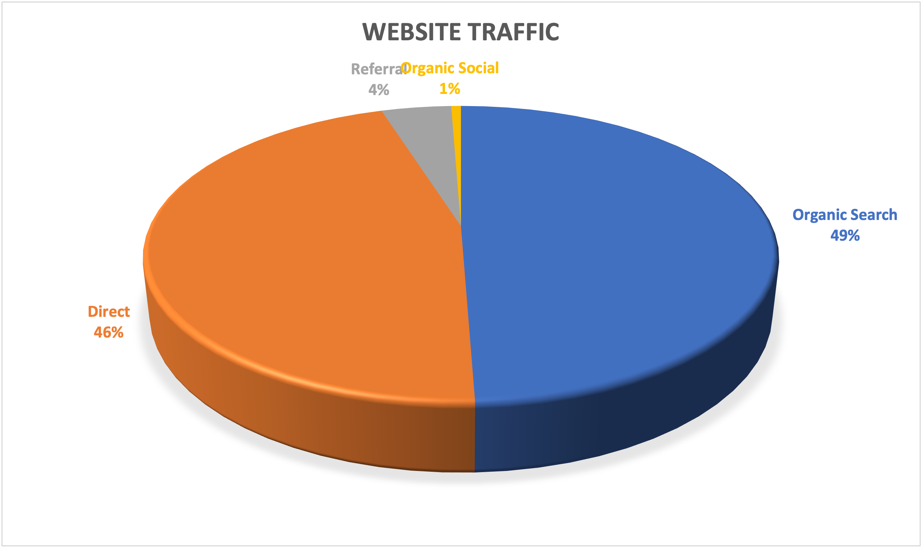


Website traffic

Slide 22



Top page performance
Page Views 3242
Page Views 1386
Page Views 2018

Slide 23
Key insights for Website
Strong Overall Traffic
Consistent visibility and user interest in NSFM's online content
Engagement
58.5% rate shows relevant, usable content
Content Strategy
Further promote high-performing areas like Parks & Recreation

Slide 24
SURVEY RESULTS
📊 Survey Participation Overview
INITIATIVE | COMPLETED | TOTAL | % COMPLETE | STATUS
Board Evaluation | 9 | 16 | 56.25% | ✅ Completed
Potential Tariffs | 24 | 49 | 49% | ✅ Completed
Funding Navigation Feedback | 35 | 416 | 8.4% | ✅ Completed
Stormwater Management Projects | 18 | 98 | 18.37% | ✅ Completed

Slide 25
MEDIA

Slide 26

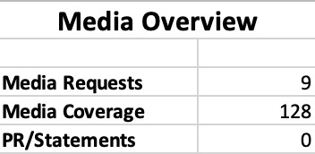
Media Overview
Notes:
MEDIA REQUESTS Apr. 8 Luke Ettinger AllNovaScotia - I am working on a story at allnovascotia.com about some rural developers expressing some frustration about the effectiveness of CMHC. I know Richmond County voted to write to NSFM asking for reflection on this in late March. Response - N/A Apr. 15 Ketih Doucette, Global - RE: Coastal Protection Press Release Response - Apr. 15 Nova Scotia moves forward with plan to force municipalities to protect coastlines Apr. 15 AllNovaScotia, Brian Flynn, AllNovaScotia - RE: Coastal Protection Press Release Response - April 16 Halman Suggests Bylaws for Local Coastal Protection Apr. 15 Suzanne Rent, Halifax Examiner - RE: Coastal Protection Press Release Response - Apr. 16 Nova Scotia announces example land-use bylaws for municipalities to protect coastlines May 15 Luke Ettinger AllNovaScotia RE: Deer Management Response - May 26 Small Businesses Look To Buck Deer Damage May 28 Maria McGowan RE: Reimagined Energy Podcast – Municipal Guest Opportunities Response - N/A Jun 11 Taryn Grant CBC RE: Uranium - I'm aware of four municipalities that have passed motions to ask the province to pause its uranium exploration plans -- Pictou, MODL, Annapolis and West Hants. Do you know of any others who have done the same? Does NSFM have a position on this issue? Response - Jun 23 Nova Scotia to do own study of 3 areas with uranium deposits without drilling or digging Jun 25 Haley Ryan CBC RE: Policing Review from the province Response - Jun 25 Nova Scotia to overhaul policing, expand RCMP role Jun 26 Sam Farley CBC NB RE: NS Code of Conduct - why this change to the new code of conduct was needed for NS and how municipalities are welcoming the change. Response - Jul 4 - N.B. codes of conduct allow for degree of council secrecy not possible under N.S. rules
MEDIA COVERAGE follows

Slide 27


TELEVISION
7 Stories
210,000 viewers from
NS, NB & PEI
4 Stories
Notes:
TELEVISION CBC News
Mar. 27 Halifax municipality buys barely anything from the U.S.
Jun 4 Glace Bay volunteer fire dept turns over budget to CBRM
Jun 9 Without better protection, residents warn N.S. coastline risks 'death by 1,000 cuts’
Jun 10 CBRM adds new firefighting equipment to its fleet
Jun 20 Halifax council passes plan to prepare city for 1 million people
Jun 23 Why this Cape Breton lookoff is a hot spot for illegal dumping
CTV News Atlantic
Mar. 25 Halifax reviews contracts with American firms amid ongoing trade war
Apr. 4 Nova Scotia will spend $250K on school garden programs
Apr. 22 Locals react to Chignecto Isthmus funding announcement
Apr. 24 Why fewer Canadians are considering buying an electric vehicle
Apr 25 Halifax mayor surprised by sewage plan
Apr. 25 Plymouth Community Centre receiving $3M to add more early learning, child-care spaces
May 13 Birds trapped in abandoned building across from Cape Breton City Hall
May 26 Halifax is the third worst city for traffic in Canada: TomTom
May 28 Halifax Regional Municipality closes Geary Street encampment site
Jun 12 Halifax municipal accounts leave X, prompting questions about emergency communications
Jun 18 HRM isn’t effectively managing its winter operations: auditor general
Jun 18 ‘Fed up with Trump rhetoric’: U.S. city renames street to honour Canada
Jun 23 Halifax deputy mayor seeking report on upcoming bike lane projects, costs
Global News
Apr. 16 Nova Scotia moves forward with plan to force municipalities to protect coastlines

Slide 28













print
4 Stories
1 Story
1 Story
40 Stories
1 Story
1 Story
1 Story
1 Story
1 Story
1 Story
1 Story
1 Story
1 Story
1 Story
Notes:
PRINT
CBC News
Mar. 19 CBRM council pledges half a million dollars toward university's capital campaign
Mar. 22 Who pays for recycling in Nova Scotia is set to change
Mar. 25 Houston government softens language in transportation bill
Mar. 27 Halifax municipality buys barely anything from the U.S.
Mar. 29 Halifax launching shared e-bike, scooter pilot program
Mar. 31 Woman plans to sell home due to stress caused by town's expropriation
Mar. 31 Former cop sues police chief and town of Amherst
Apr. 1 Municipality of Barrington selling off wind turbine
Apr. 2 N.S. to ignore plebiscite, keep Port Hawkesbury's main street at three lanes
Apr. 6 Council decision to close public spring upsets Colchester residents
Apr. 7 N.S. government asked municipalities to support more resource development. It hasn't happened
Apr. 11 Digby Arena gets $1.5M from province for structural, mechanical upgrades
Apr. 14 N.S. government will oversee recovery of abandoned tidal turbine
Apr. 15 Nova Scotia moves forward with plan for municipalities to protect coastlines
Apr. 16 Does Nova Scotia's hiked deed transfer tax help or hurt housing?
Apr. 17 Greenwich, Wolfville fire departments will not merge, despite years of talks
Apr. 22 How a Nova Scotia town quietly decided to stop fluoridating its water
Apr. 23 Halifax CAO says poor fiscal transparency grade not 'completely accurate’
Apr. 24 Cape Breton police appealing for help after second shooting in Sydney Mine
Apr. 26 'We feel violated': Pictou residents frustrated by thefts targeting historic plaques
Apr. 27 Pictou councillor resigns after clashing with town CAO
Apr. 28 'If you build it, people will come': Swim Nova Scotia pitches new pool for Annapolis Valley
Apr 30 Halifax expanding Sackville rivers floodplain
May 5 Nova Scotia Guard deployed for 1st time to support search for missing children
May 7 CBU approves 2025-26 operating budget that includes $6.8M deficit
May 12 Westville mayor says school redevelopment could be 'game changer' for town
May 14 Halifax moves ahead with downtown Dartmouth heritage district
May 15 'I'm very concerned': N.S. government to intervene in Halifax Water rate hike case
May 20 'A total surprise': Municipalities unprepared for uranium exploration in their backyard
May 23 'It's nauseating': Residents in Kentville, New Minas raising stink about sewage plant odou
May 24 Interveners pile up in Halifax Water rate case
May 26 'Very disheartening,' says resident whose property could be explored for uranium
May 27 How Halifax Water communicated major boil-water order leaves 'serious questions to answer,' says Councillor
May 29 N.S. commits to fix for municipalities waiting on marketing levies from booking platforms
Jun 2 Hants County residents voice concerns over 'undesirable' uranium mining proposal
Jun 3 Pictou County council votes to ask province to pause uranium plans
Jun 16 CBRM councillor expects increasing conflict between new housing, property owners
Jun 18 Nova Scotia village moves to drop 'Cornwallis' from its name
Jun 26 N.S. mayors concerned province 'pushing' municipal police out as government expands RCMP role
Jun 27 Stewiacke slows development pending new water treatment plant
The Advocate
May 16 Affordable housing options spark interest
Insurance Journal
Mar. 27 Unusually Active Hurricane Season in Store for the Atlantic: AccuWeather
Annapolis Valley Register
Apr. 7 Windsor flood zone residents urging action to address chronic issue
The Tri-County Vanguard
Apr. 30 Six municipal infrastructure projects receive provincial funding
May 2 How to turn more unused buildings into affordable housing
May 2 Flood adaptation tools coming for Nova Scotia municipalities: NSFM
May 9 Six infrastructure projects receive provincial funding
News Minimalist
Mar. 18 Halifax proposes new floodplain rules for Sackville River
Education News Canada
Apr. 9 - Funding for School Gardens Provides Fresh, Healthy Food for Students
Policy Options
Apr. 3 Canada’s policy reset needs to go much further than trade to address Trump shock effects
RenewCanada.net
May/June 2025 - The importance of preparing for extreme weather, driven by irreversible climate
GlobeSt.
May 13 How Building in Climate Resilience Can Become a Commercial Real Estate Edge
Carrier Management
May 12 Commercial Property Customers Cutting Insurance Corners Despite Risk
Western News
May 26 Expert explainer: How to protect your home from wildfires
Grand Forks Gazette
Jun 7 How to help protect your home from wildfire
EQ GlobeNewswire
Jun 27 Media Statement: NPF Welcomes Nova Scotia’s Policing Reforms and Continued Partnership with RCMP

Slide 29







Radio
17 Stories
10 Stories
10 Stories
8 Stories
2 Stories
1 Story
1 Story
Notes:
RADIO
Mar. 19 - 101.5 The Hawk - Have ideas to improve Port Hawkesbury? Here is an opportunity!
Apr. 2 - CKBW - Bridgewater passes budget with no change to tax rates
Apr. 2 - CKBW - Do you live in an area with poor cell coverage? Report it!
Apr. 4 - Y95.5 - Yarmouth launching second deer survey as part of long-term management plan
Apr. 11 - CKBW - MODL mayor says new budget process improved transparency, boosted public understanding
Apr. 11 - 101.5 The Hawk - Does Antigonish need a new rec centre? Local group looks into it
Apr. 14 - Y95.5 - MODY develops strategic plan through 2029
Apr. 15 - 101.5 The Hawk - Cities can now use templates to create coastal protection by-laws
Apr 16 - CKBW - I Didn’t Know So Many NS Towns Had Their Own Flags! Check It Out!
Apr. 16 - Y95.5 - Tax rates stay put in Municipality of Shelburne
Apr. 22 - 101.5 The Hawk - Inverness County gathering feedback for new Port Hood park
Apr. 23 - 101.5 The Hawk - Billy Joe MacLean, long-time mayor of Port Hawkesbury and former cabinet minister dies
May 1 - CKBW - Bridgewater seeks feedback on development plans near Exit 12A
May 1 - Y95.5 - MODY approves phase 2 of Nova West Regional Business Park
May 6 - Y95.5 - MODY gets accessibility funding for municipal building
May 12 - Y95.5 - Congres Mondial Acadien wins ‘Event of the Year’ at ECMAs
May 15 - Y95.5 - Yarmouth Mayor eager to welcome American visitors on ‘CAT’
May 15 - CKBW - MODL approves $150,000 in grants to support local groups and infrastructure
May 15 - 101.5 The Hawk - ‘They need answers’, warden says sadness grips N.S. community where kids went missing
May 22 - 101.5 The Hawk - Port Hawkesbury wins workplace safety award
May 23 - 101.5 The Hawk - Town, municipality fund Antigonish Transit Society
May 26 - 101.5 The Hawk - St. Peter’s is getting a brand-new splash pad
Jun 2 - 101.5 The Hawk - Work on Baddeck’s waterfront begins
Jun 4 - 101.5 The Hawk - Taxes going up for town of Antigonish in new budget
Jun 4 - 101.5 The Hawk - Several groups come together to denounce new tariffs
Jun 9 - 101.5 The Hawk - Projects in Guysborough-Tracadie receive provincial funding
Jun 11 - Surge 105.1 - N.S. municipalities advocate for better rural healthcare
Jun 12 - CKBW - No decision yet on rent cap extension, says housing minister
Jun 12 - 101.5 The Hawk - Premier backs Halifax mayor on rejected bike lane pause
Jun 12 - CKBW - Mahone Bay approves budget, residential and commercial rates up 1%
Jun 12 - Y95.5 - Town of Yarmouth bumps up tax rates as costs rise
Jun 20 - 101.5 The Hawk - Local company hired to prepare site for grid modernization project in Antigonish
Jun 23 - 101.5 The Hawk - 144 child-care spaces coming to Antigonish county
Jun 25 - 101.5 The Hawk - N.S. moving toward province-wide RCMP
Jun 25 - Y95.5 - Argyle residents hear next steps in ADA program
Jun 26 - Y95.5 - Second meeting happening on Plymouth connection trail
CityNews 95.7
Mar. 31 Deed transfer tax hike won’t hurt cottage demand, real estate agency says
Apr. 3 Additional funding announced to support gender-based violence initiatives
Apr. 8 Halifax council approves billion-dollar budget
Apr. 16 Halifax gets failing grade for fiscal accountability in national report
Apr. 21 Halifax utility diverting millions of cubic metres of wastewater into harbour, basin
May 15 N.S. gets $170M over decade after signing housing infrastructure deal
May 20 Nova Scotia takes feds to court, saying it must protect land link
May 27 Councillor calls for municipal strategy to tackle commercial, industrial litter
Jun 4 Sustainable Provincial Funding for Regional Libraries Raised at Port Hawkesbury Town Council
Jun 7 Regional council looks to extend Student Transit Pass Pilot Program
989 XFM
May 6 Pictou County Councillors disappointed with Minister John Lohr over lower setbacks of Wind Turbines from Residential Property
Jun 25 Richmond asking NSFM to make involuntary destruction an advocacy issue
CBC Radio
Jun 16 Drought conditions across Canada continue to worsen

Slide 30

Online
3 Stories
Notes:
ONLINE
Government of NS
Apr. 22 Government Funding for Warming Centres at Islamic Centres, Colchester Transit Study
Apr. 24 Province Supports Growth for Municipalities
Apr. 24 Supporting Municipal Projects Announcement

Slide 31
eNewsletter

Slide 32
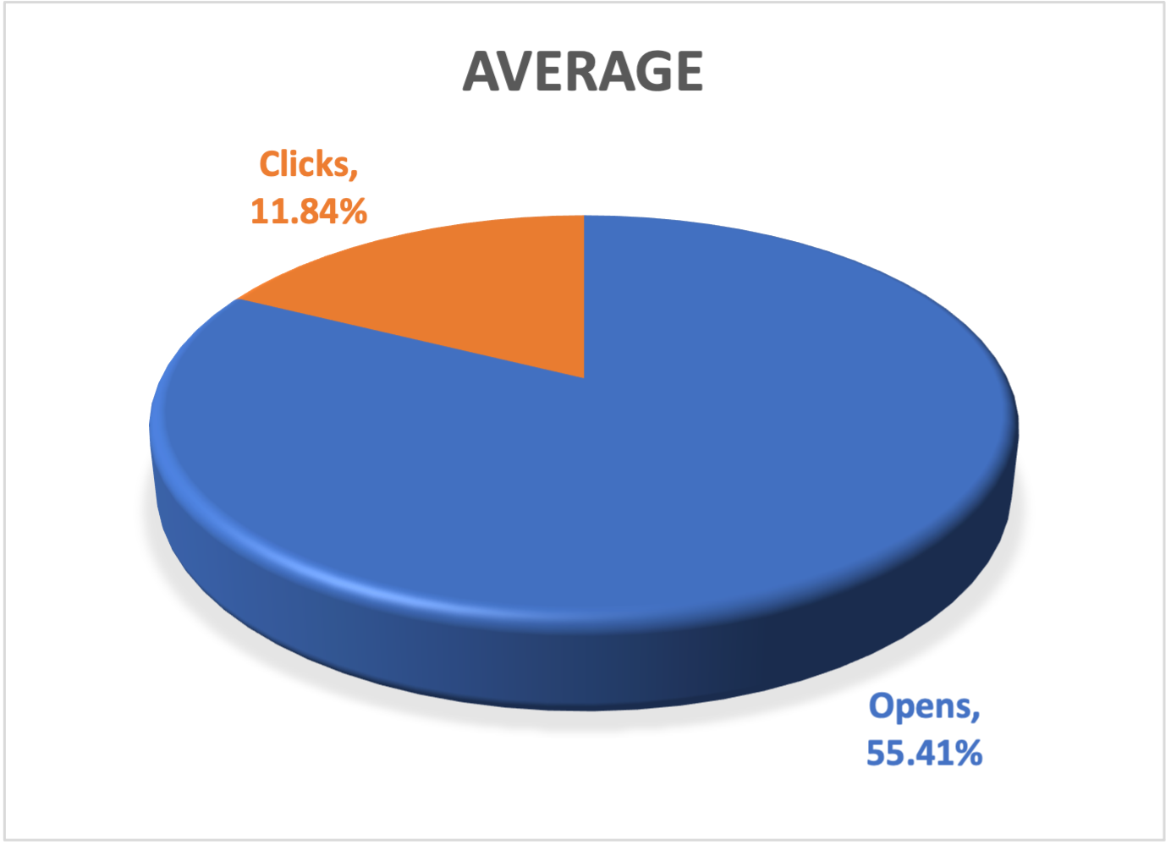
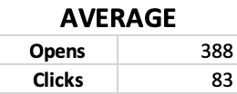
Monday Memo
Notes:
Audience/Distribution 701

Slide 33



TOP performing Content
95 Clicks
74 Clicks
69 Clicks

Slide 34
Key insights for Monday memo
Average Open Rate
55.41% is well above typical industry averages (20-30%), indicating strong subject lines or subscriber interest.
Average Click Rate
11.84% is a strong result reflecting relevant and engaging content inside the emails.

Slide 35
SCCF UPDATE

Slide 36
SCCF Website UPDATE

Slide 37
SCCF Website UPDATE

Slide 38
SCCF Website UPDATE

