Slide 1

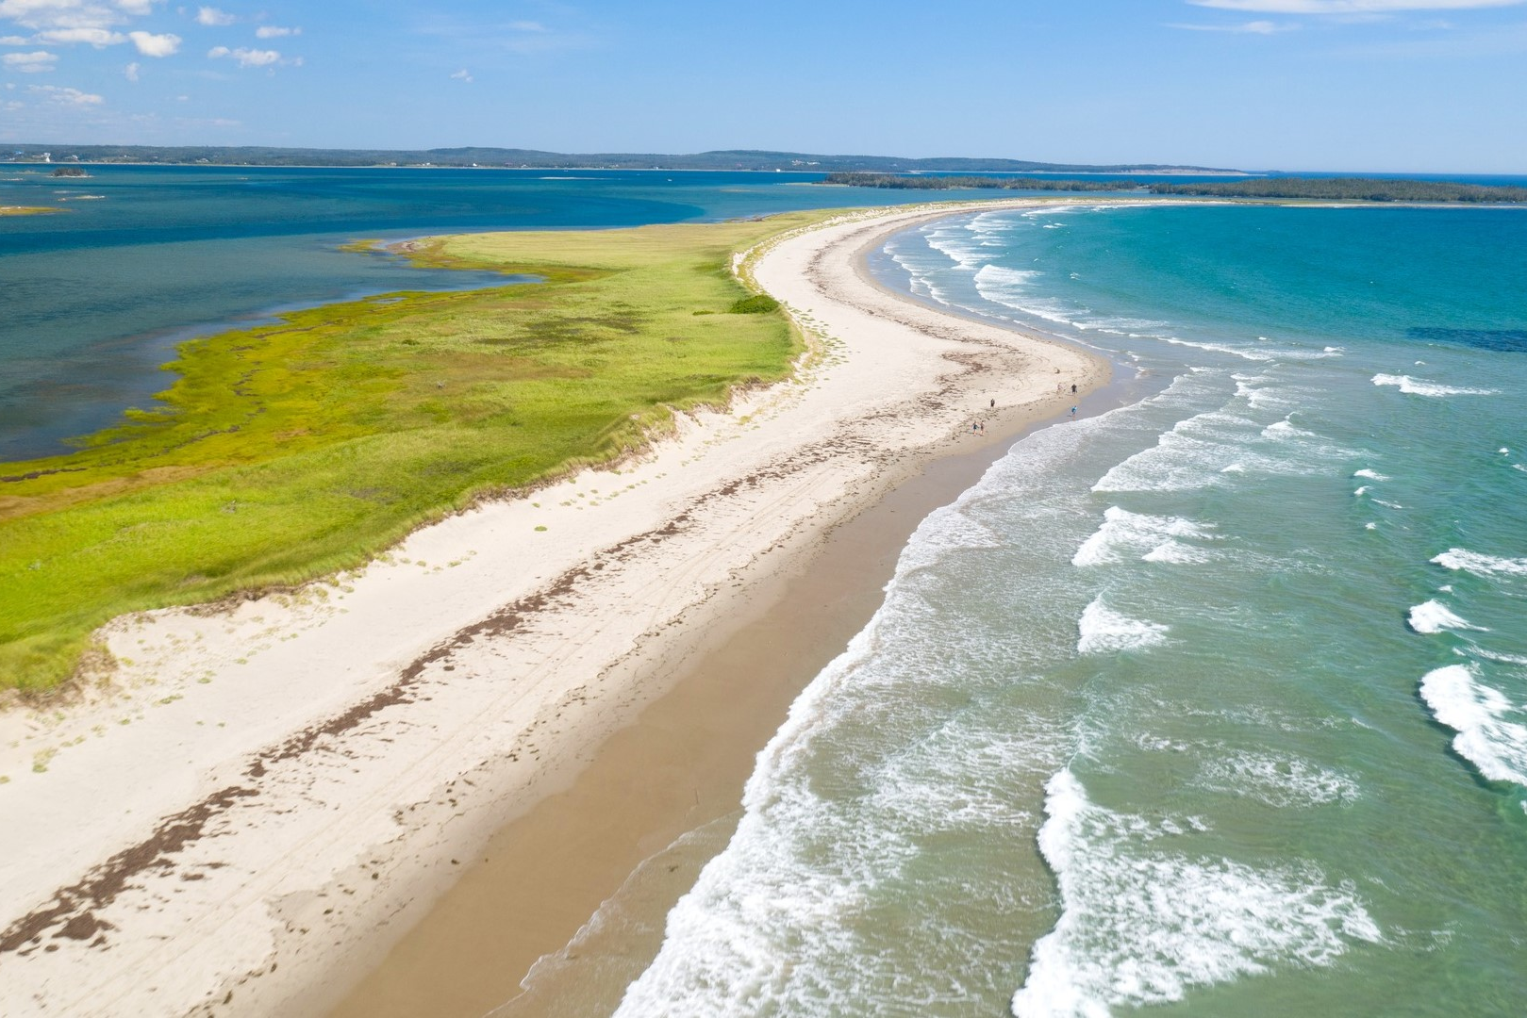
Coastal Land use planning -Update
Presentation to NSFM Board
Date: Sep. 26, 2025
Confidential

Slide 2
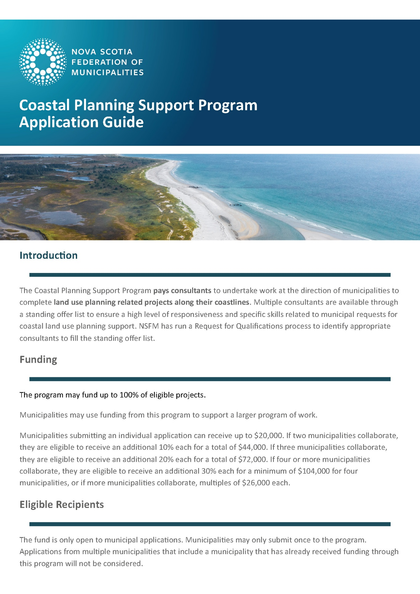
Coastal Planning
Support Program
Due to launch on October 15
Pays consultants to undertake work at the direction of municipalities to complete land use planning related projects along their coastlines related to:
    Interpreting coastal and climate data to guide safe development
    Supporting collaboration and decision-making
    Assisting with public engagement and communications
    Providing guidance for coordinated implementation

Slide 3
Coastal Planning
Support Program
The program may fund up to 100% of eligible projects.
Base funding of $20,000 for individual municipalities. Amount per municipality increases when more municipalities collaborate.
Basic two-page application.
One-page reporting at completion.
Request for Qualifications has made seven consulting firms available on a standing offer list.

Slide 4
Coastal Planning
Support Program
NSFM will also host information sessions for questions and discussion:
Mon, Oct 20 – 9:00 AM | Port Hawkesbury Civic Centre, Shannon Studio
Mon, Oct 20 – 2:30 PM | Glengarry Best Western, MacDonald Room, Truro
Thu, Oct 23 – 9:00 AM | Kentville Recreation Centre, Lower Meeting Space
Thu, Oct 23 – 2:30 PM | Mariners on Main, Yellow Room, Yarmouth
Fri, Oct 24 – 10:00 AM | Lunenburg County Lifestyle Centre, Multi-purpose Room, Bridgewater

Slide 5
Other Efforts
Creating Coastal Policy Decision Guide for Municipal Councils
Working with CLIMAtlantic to prepare a Request for Proposals
Likely a two-stage process
    Workshop to establish scope of work for the guide to ensure it meets municipalities where they are at. Participants would be NSFM, Dept. of Municipal Affairs, Dept. of Environment and Climate Change, CLIMAtlantic, Clean Foundation, Municipalities, etc
    Creation of the guide
Regular meetings with Coastal Lead, Flood Coordinator and Stormwater Engineer at Province to coordinate efforts and advocate for municipal supports

