Slide 1

Statements of Provincial Interest (SPI) Housing and Infrastructure
Christina Lovitt, Provincial Director of Planning
Saira Smith, Senior Planner
Paul Beesley, Senior Policy analyst

Slide 2

Planning for the Public Good
Provincial interest in land use:
public health and safety,
protection of our environment,
sustainable use of our natural resources,
effective investment in infrastructure,
and have affordable and special-needs housing available.
Five SPIs (1999) define provincial interests and encourage municipalities toward more sustainable development.
Drinking Water, Flood Risk Areas, Infrastructure, Agricultural Land, Housing
SPIs work together, no one SPI takes precedence.
Provincial activities shall be reasonably consistent.
Purpose is to protect the common public interest; not to restrict or regulate development.

Slide 3
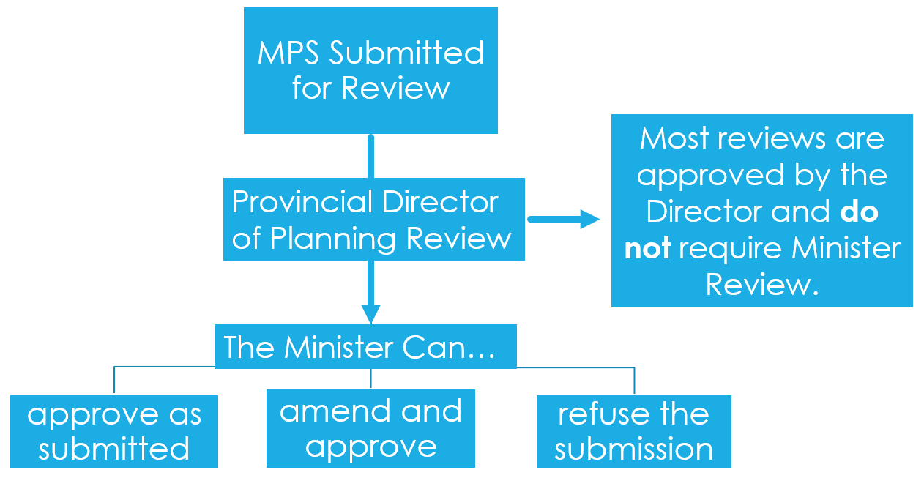
Provincial Review Process

Slide 4
Housing
Goal
To provide housing opportunities for all Nova Scotians.
Provisions
Planning documents must address affordable housing, special-needs housing and rental accommodations by identifying needs and including solutions to address needs.
Basis
Adequate shelter is a
fundamental requirement
A range of housing types can be encouraged by allowing higher densities, smaller lot sizes and reducing yard requirements.
Group homes (small option homes) that appear like single detached dwellings need to be permitted in all areas that allow single detached dwellings.
Application
All communities.
Manufactured homes must be permitted.

Slide 5
Infrastructure
Goal
To efficiently use municipal water supply and wastewater.
Provisions
Planning documents must promote the efficient use of existing infrastructure and reduce the need for new services in unserviced areas.
Basis
Encourage development in serviced areas to avoid costly infrastructure expansions and make the most of existing systems.
Enable infill development on vacant lots, consider higher densities in serviced areas, permit expansion of services in locations that are most cost efficient.
Identify known problems related to existing infrastructure and plan to address those issues.
Application
All communities.
Enable alternative wastewater disposal systems when problems arise. Discourage Installing municipal water systems without municipal wastewater disposal.

Slide 6
Current State
Many municipalities are experiencing growth, housing and infrastructure work in tandem to meet the needs of a growing population
Jurisdictional scans including conversations with other provinces (Ontario, Manitoba, and Saskatchewan)
Muniscope research
Internal research on topics of interest
Internal Provincial Department Engagement and engagement with municipal planning directors
Engagement with AMANS

Slide 7
SPI Ideas for Housing and Infrastructure
planning for current and projected needs for housing and infrastructure, including infrastructure plans
development potential for all housing types along the housing spectrum
Modernizing the language in the SPIs
identifying the housing and infrastructure needs of equity groups in the municipality and developing solutions appropriate to the planning area
Alterative service systems such as cluster systems to enable services in unserviced areas
Conflict resolution to encourage shared infrastructure services

Slide 8
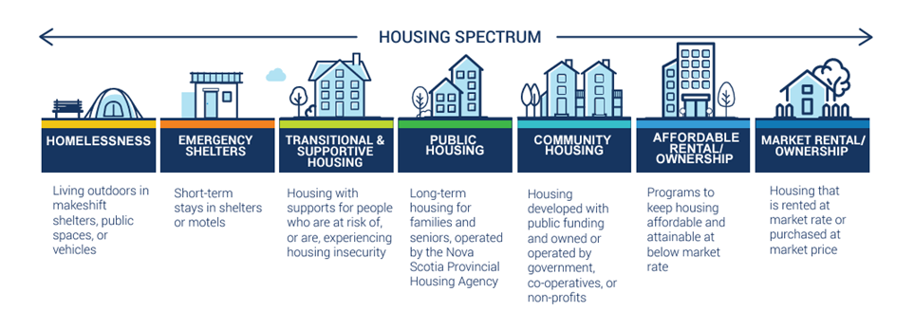
Housing Spectrum

Slide 9
Next Steps
External Engagement with municipalities (three virtual meetings) with discussion opportunities and an online survey to enable more detailed comments
Engagement with key housing and infrastructure groups
Formal engagement with municipal councils, as per Section 194 (1) of the MGA and Section 210 of the Halifax Regional Municipality Charter, will take place once draft SPIs are prepared.

