Slide 1
NSFM Q4 2024 Communications
Report
January 1, 2025

Slide 2
EXECUTIVE SUMMARY

Slide 3
EXECUTIVE SUMMARY
The fourth quarter of 2024 marked a dynamic period for NSFM communications, driven by key initiatives such as the NSFM Board of Directors Election Campaign, promotion of the Fall Conference, Municipal Code of Conduct In-Person Training Sessions, and the launch of Committee Opportunities 2025. This busy quarter reflected our commitment to fostering member engagement and delivering timely, impactful messaging across all platforms.
The following report provides a detailed analysis of our communications performance, encompassing social media channels, the NSFM website, media coverage, and our eNewsletter, the Monday Memo.

Slide 4
SOCIAL CHANNELS

Slide 5
Social Media Definitions
Commonly used terms in Social Media Content Analysis:
Clicks: refer to the total number of times users clicked on any clickable element in your content. This includes not just links but also buttons, images, or other interactive features within the post. It gives a broader view of how often people are interacting with your content beyond just link clicks.
Reactions: The responses users give to a post, such as likes, loves, laughs, or other emoji reactions. This metric shows how people feel about the content.
Engagement Rate: The percentage of people who interact with your content (e.g., likes, comments, shares, clicks) compared to the total number of people who saw it. It measures how engaging or effective your content is.
Link Clicks: The number of times users clicked on a link in your post or content, leading them to another webpage or destination.
Reach: The total number of unique users who have seen your content at least once. It reflects how many different people your content is reaching.
Content Interactions: Any action users take on a post or piece of content, such as liking, commenting, sharing, or clicking. This measures overall activity or interaction with the content.
Impressions: The total number of times your content was displayed or shown on a screen, regardless of whether it was clicked or interacted with. This counts repeat views by the same person.

Slide 6
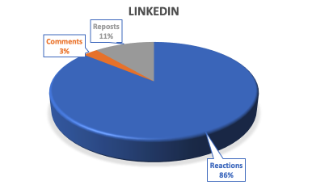
linkedin
Follower Growth – 6.00%
Oct. 1 – 1173
Dec. 31 – 1,243

Slide 7



Top Performing Content
Clicks 22
Clicks 21
Clicks 20

Slide 8
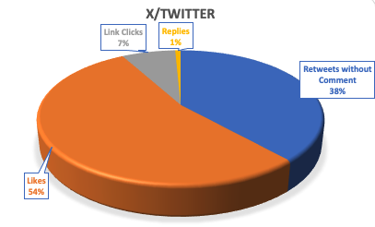

x/twitter
Follower Decrease 2.00%
Oct. 1 – 1,121
Dec. 31 – 1,100

Slide 9



Top Performing Content
Views 1342
Views 723
Views 215

Slide 10


FACEBOOK
Follower Growth 5.00%
Oct. 1 – 753
Dec. 31 – 794

Slide 11



Top Performing Content
Views 1969
Views 1142
Views 1111

Slide 12
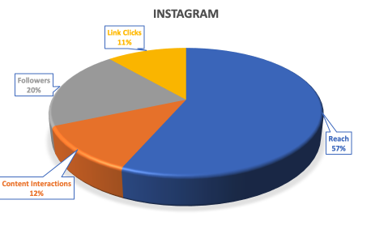

Instagram
Follower Growth 1.00%
Oct. 1 – 258
Dec. 31 – 279

Slide 13



Top Performing Content
Views 141
Views 136
Views 127

Slide 14
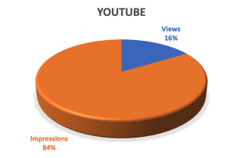

youtube

Slide 15
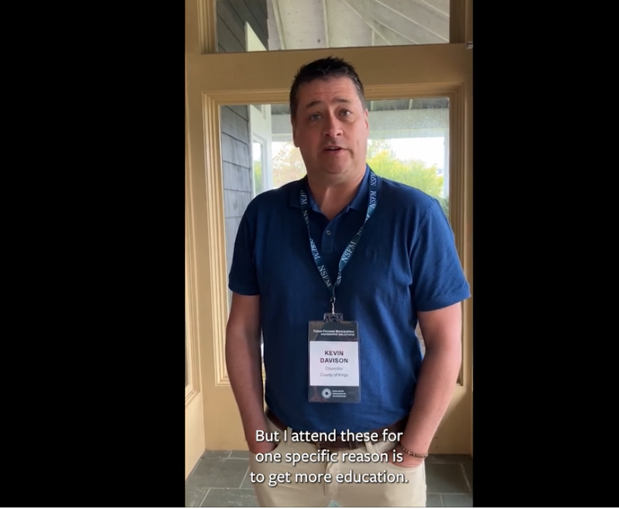

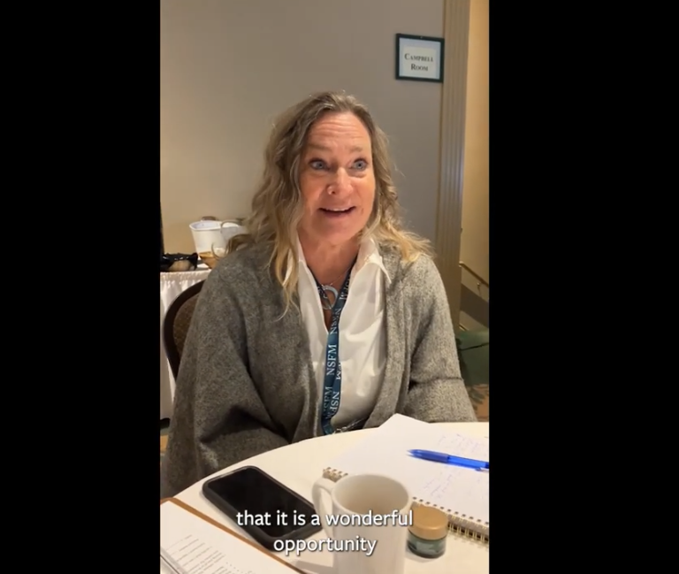
Top Performing Content
Views 29
Views 24
Views 20

Slide 16
NSFM Website

Slide 17
Online Definitions
Commonly used terms in Online Content Analysis:
Organic Search: Visitors who land on your website or content through unpaid search engine results, such as Google or Bing, without any paid ads.
Direct: Traffic that comes to your website directly, either by typing your URL into a browser or clicking on a saved bookmark.
Referral: Traffic that comes to your website from another site via a link, excluding social media or search engines.
Organic Social: Traffic or visitors that come to your website from unpaid, non-boosted posts on social media platforms (e.g., from regular posts, not ads).

Slide 18



Website traffic

Slide 19



Top page performance
Page Views 4039
Page Views 1338
Page Views 1560

Slide 20
MEDIA

Slide 21
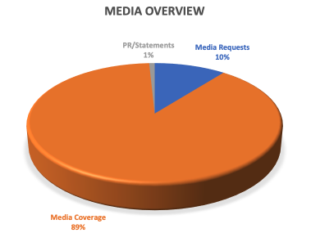

Media Overview
Notes:
PRESS RELEASES
Nov. 21 - News Advisory for Fall Conference
MEDIA REQUESTS
Oct. 4 - Eva Moores from DMAH - Quote from Carolyn Bolivar-Getson for Press Release on the Growth and Renewal for Infrastructure Development program
Oct. 16 - Giuliana Grillo de Lambarri, Reporter for CBC Nova Scotia -
I'm reaching out because I came across a Request for Decision from the Municipality of District Lunenburg about the installation of generators at the three Wastewater Pump Stations in Conquerall Bank, Cookville and New Germany. If you want more information, here's the link to their council meeting agenda, the topic starts on page 6: https://www.modl.ca/index.phpoption=com_docman&view=download&alias9171-2024-10-08councilagendapackage&category_slug=2024-10-08-council-meeting&Itemid=1160 This made me curious about how many municipalities don't have generators in some or all of their water treatment facilities and pumps. That is why I am reaching out to the NSFM to ask if you happen to know anything about this subject and, if so, if you could share It with me.
Oct. 21 - Catherine Morasse, Radio-Canada Halifax - I would like to compare my data with past data to compare how gender parity evolved in municipal councils through the years. I was wondering if the Federation of Municipalities had some data I could use for my piece? Raw data would be ideal, although it could also be aggregated (this information sheet is a good example of aggregated data I could use, but the numbers are from 2018, so they're not recent enough to compare this election with the last election in 2020).
Oct. 25 - Cassidy McMackon, Reporter/Editor, The Canadian Press - I'm writing a story about the first-ever all women council that was elected in Annapolis Royal last week and I'm looking for some data to contextualize the piece. Does the Nova Scotia Federation Municipality have any information on other municipalities in the province that have had all-women councils, or councils that have been predominantly made up of women? Please let me know if you keep track of this information and can send the names of the municipalities (if any) that have been lead by all women.
Oct. 29 - Chris Brown - Cross Border Interview Podcast - Just wondering who I could speak with regarding the Provincial Election call from a Municipal Standpoint. What will Municipalities be looking for? What do they want to hear from the party leaders
Nov. 1 - Jennifer Jo Henderson, Reporter, The Halifax Examiner - It's about coastal protection efforts in the province. Since March when the Province turned over responsibility to municipalities to come up with rules and regulations for how close people can build to the coast, I am wondering what progress has been made on creating a single template that might be adopted by each municipality as a basis for a bylaw or regulation so each municipal unit wouldn't have to "reinvent the wheel" in coming up with the best setback or best language to regulate development. question 1, is there a single template municipalities can use? Is one being developed? question 2, if you know the answer could you share with me as estimate of how many municipal units currently have regulations around building too close to the water?
Nov. 8 - Chris Brown - Cross Border Interview Podcast - Do you have a list of the candidates for nsfm board election available?
Nov. 27 - Chris Meyer of Municipal World - Requested an interview with New President Pam Mood
Nov. 29 - Chris Brown - Cross Border Interview Podcast - a series of "Year in Review" features with PTA association Presidents to reflect on the events, achievements, and challenges of the past year. I would be delighted to have newly elected NSFM President Pam Mood on the show to gain insights into how the municipalities in Nova Scotia have fared over the last 12 months. I’m specifically interested in exploring the following: The major successes and milestones achieved in 2024; the challenges or obstacles municipalities have faced and how they were addressed/or are being addressed; and, if possible, discussing NSFM’s priorities for 2025 and what the organizations priorities will be heading into the new year. Also would love to chat with her about her election as President, and the re-election of Tim Houston PC’s in Nova Scotia.
Dec. 3 - Luke Ettinger the CBC Nova Scotia Reporter - to speak to Pam Mood about the Municipal Code of Conduct. Specifically what concerns we’ve heard from municipalities about it’s implementation (i.e. if it’s an investigation rather than a tribunal). What concerns you are fielding at NSFM about some of the finer details and if you are working with the province to alleviate any of them?
Dec. 3 - Paul Bacon with All Nova Scotia - Interview with Pam Mood
Dec. 3 - CJLS/Y95.5 - Interview with Pam Mood
Dec. 4 - Todd Veinotte Host 957 News Radio - regarding Municipal Code of Conduct
MEDIA COVERAGE follows

Slide 22


TELEVISION
10 Stories
210,000 viewers from
NS, NB & PEI
9 Stories
Notes:
TELEVISION
CBC News
Oct. 2 Halifax mayor bids farewell at final council meeting
Oct. 21 N.S. municipal elections bring in new faces as some incumbents defeated
Nov. 15 Hordes of giant rats are a problem, say Cape Breton residents
Nov. 18 Yarmouth to remove transit fees, add more stops
Nov. 29 Municipalities call on re-elected Houston government to revisit coastal protection
Dec. 3 Cape Breton investigating last year of municipal credit card transactions
Dec. 3 Motion to scrap designated encampment sites defeated in narrow Halifax council vote
Dec. 6 Federal government commits more than $5M to Kings Transit Authority in Nova Scotia
Dec. 10 Truro and Colchester to explore expanding public transit with feasibility study
CTV News Atlantic
Oct. 2 N.S. town disappointed with ferry cancellations
Oct. 4 Halifax mayor gets lifetime supply of donairs
Oct. 11 New disaster debris management plan for Cape Breton Regional Municipality will help with weather-related events
Oct. 13 Halifax Mayor Mike Savage named new lieutenant-governor of Nova Scotia
Oct. 24 Pictou County municipality 'deeply concerned' about rise in animal attacks
Oct. 25 Small Nova Scotia town elects its first all-women council
Oct. 30 New CBRM mayor, council talks priorities, provincial government relationship during swearing-in ceremony
Nov. 12 New Halifax council meets for first time
Nov. 13 Halifax's new mayor talks traffic problems, future additional encampment sites
Dec. 17 Halifax mayor says city is past the worst of its housing crisis, advocates disagree

Slide 23










print
32 Stories
6 Stories
1 Story
1 Story
1 Story
1 Story
1 Story
1 Story
1 Story
2 Stories
1 Story
Notes:
PRINT
CBC News
Oct. 2 Halifax councillors question 'reckless' planning changes required by province
Oct. 3 CBRM councillor says election opponent should be disqualified for not taking leave sooner
Oct. 4 Ottawa wants to offload this office building. Nova Scotia wants it to house homeless people
Oct. 6 Parts of Municipality of Colchester to hold plebiscite on managed deer cull
Oct. 6 Repair bills near $3M for Elmsdale pool shut down for almost a year due to flooding
Oct. 9 'Huge disappointment': Suspension of ferry to N.B. has Digby worried about economic losses
Oct. 10 Questions of N.S.'s capabilities to protect vulnerable people arise amid hurricane season
Oct. 12 Lunenburg to move forward with Cornwallis Street name change
Oct. 15 Retreat from the coast: Nova Scotia prepares to move iconic road to adapt to climate change
Oct. 14 West Hants wants more space between wind turbines and private land. Developers aren't happy
Oct. 17 Next cohort of Antigonish County councillors to tackle coastal protection
Oct. 18 Many municipal leaders defeated in Saturday's election
Oct. 21 Mulgrave mayor 'pretty darn scared' after run-in with coyotes as frequent sightings reported
Oct. 22 Voters with disabilities eventually cast ballots after complaints in Richmond County
Oct. 20 Annapolis Royal elects all-women council, mayor
Oct. 23 Residents vote for deer hunt in some Colchester County communities
Oct. 23 1 box, 2 names: Random draw could decide election winner in tied Cape Breton district
Oct. 26 Strong sewage odour in Antigonish repels residents, tourists
Oct. 28 Why pay for jurors became an issue at Saint John murder trial
Oct. 31 Lunenburg municipality getting 2 generators for sewage systems to counter blackouts
Oct. 31 Controversial Halifax waste facility could move ahead after court rules councillors biased
Nov. 12 N.S. municipalities defend housing fund Conservatives have promised to cut
Nov. 12 CBRM to seek new chief administrator after top staffer announces retirement
Nov. 14 N.S. government, railway company settle lengthy legal battle over Hantsport aboiteau
Nov. 18 Halifax urges people who need extra help in emergencies to join registry
Nov. 19 Wolfville doesn't have resources to deal with growing homeless problem, staff say
Nov. 20 Port Hawkesbury council grappling with municipal plebiscite results
Nov. 21 Residents ask N.S. Supreme Court to overturn provincial approval of Fall River development
Nov. 25 Port Hawkesbury residents, council unhappy with Remembrance Day traffic
Nov. 26 Richmond County hopes new code of conduct will eliminate previous issues
Dec. 4 - N.S. municipalities welcome provincewide code of conduct, but not without questions
Dec. 11 CBRM buys land next to Centre 200 for transit hub, possible arena expansion
The Laker News
Nov. 25 NSFM 2024 Fall Conference set to take place in Halifax
Saltwire
Oct. 1 Kings, N.S., site spared, others sprayed before 2024 aerial glyphosate season ends
Oct. 2 Municipal Election 2024: Municipality of Digby sees 11 people vying for 5 seats
Oct. 11 Kings, N.S., council renews call for provincial aerial herbicide spray moratorium
Oct. 30 Meet Doug Glasser, the new mayor of Stewiacke, N.S.
Nov. 12 HRM councillor calls for report on collisions between Halifax Transit buses, pedestrians
Nov. 29 Yarmouth Mayor Pam Mood back as president of Nova Scotia Federation of Municipalities
The Coast
Nov. 13 Halifax climate plan HalifACT 'at risk' of failing
CFIB
Oct. 3 Small businesses outline key priorities ahead of Nova Scotia municipal elections
Canadian Underwriter
Oct. 23 National coalition urges immediate attention to climate change file
Vancouver is Awesome
Oct. 21 Record disaster claims raise concern over the future of Canadian insurance
Rocky Mountain Outlook
Nov. 1 Nova Scotia election: Liberals promise to establish inquiry into illegal fishing
EOS
Oct. 30 Ordinary Policies Achieve Extraordinary Climate Adaptation
Cape Breton Post
Dec. 10 CBRM councillor has questions about provincewide municipal code of conduct policy
Dec. 11 CBRM to seek amendment to mandated N.S. municipal code of conduct
Annapolis Valley Register
Dec. 27 Annapolis councillor raises question about cost of national conference

Slide 24






Radio
12 Stories
8 Stories
5 Stories
8 Stories
3 Stories
1 Story
Notes:
RADIO
Oct. 3 - 101.5 The Hawk - N.S. gets wildfire prevention funding
Oct. 7 - Y95 - N.S. Premier stands firm on Chignecto Isthmus
Oct. 8 - CKBW - Centenial Bridge repair work underway
Oct. 9 - 101.5 The Hawk - Construction begins on wastewater treatment plan in Inverness County
Oct. 17 - Y95 - Podcast: Live broadcast of Insights at Annual Atlantic Network Conference
Oct. 21 - 101.5 The Hawk - Annapolis Royal makes history electing all female council and mayor
Oct. 21 - Surge 105.1 - New Code of Conduct for municipal officials in N.S.
Oct. 24 - Y95 - Podcast: Speaking truth to Canadians about their public service
Nov. 8 - CKBW - Chester reappoints Allen Webber as Warden
Nov. 8 - Y95 - Nicole Albright becomes first ever female warden in Argyle
Nov. 12 - Y95 - Linda Gregory named Digby warden for 9th time
Nov. 13 - CKBW - Barrington’s new recreation centre aiming to open next summer
Nov. 13 - CKBW - Shelburne hosting accessibility engagement sessions
Nov. 13 - CKBW - Bridgewater and Lunenburg select Deputy Mayors
Nov. 13 - 101.5 The Hawk - Antigonish ready for festive fun at Santa Claus parade
Nov. 14 - Y95 - Town of Yarmouth to make public transit system free for all
Nov. 14 - 101.5 The Hawk - Town to remove gunk from Antigonish sewage plant to rid of awful smell
Nov. 18 - CKBW - Penny Smith chosen as Shelburne warden for third time
Nov. 21 - Y95 - Yarmouth town council recommends cull to curb deer problem
Nov. 22 - CKBW - Queens Provides More Info on water conservation efforts
Nov. 29 - CKBW - Yarmouth Mayor Pam Mood re-elected as NSFM President
Dec. 3 - CKBW - Bridgewater Rolls out free parking and transit for the Holidays
Dec. 3 - CKBW - Former Halifax Deputy Mayor hired as Queens Municipal Clerk
Dec. 5 - 101.5 The Hawk - Community hub coming to St. Peter’s will ‘bring life’ into rundown building
Dec. 5 - 101.5 The Hawk - Mood to advocate for municipalities as NSFM president
Dec. 10 - CKBW - Bridgewater Council approves zoning changes and land donation for daycare
Dec. 31 - 101.5 The Hawk - Antigonish mayor proud of milestones heading into 2025
Dec. 31 - CKCW - MODL Mayor Elspeth McLean-Wile reflects on key priorities for 2025
CityNews 95.7
Oct. 21 N.S. government sets up code of conduct for province’s municipal politicians
Nov. 14 Over 100,000 people asked to conserve water due to low levels in Lake Major
Nov. 22 Cape Breton councillor wins election after her name is picked from a box
Nov. 30 New Barrington Street transit terminal to open Dec. 16
Dec. 10 Halifax Water lifts conservation measures at Lake Major
989 XFM
Oct. 19 Results from the Nova Scotia Municipal Elections Locally-Final Results
Dec. 11 Port Hawkesbury Mayor Brenda Chisholm-Beaton to Serve as Past President of the Nova Scotia Federation of Municipalities
Dec. 17 Richmond County Looks at Feasibility of Adding Electric and Hybrid Vehicles to the Municipality’s Fleet

Slide 25



Online
4 Stories
1 Story
1 Story
Notes:
ONLINE
Oct. 19 Chris Brown, Cross Border Network - BREAKING: Double Leadership Shakeup for Municipal Federations
Dec. 4 - Colin Chisholm - New Council Whacks Back Fillmore's Encampment Plan
Government of NS
Oct. 11 Province Funds CBRM Disaster Debris Cleanup Plan
Oct 18 New Program Supports Municipal Infrastructure Priorities
Oct. 18 Acadian Museum Going Green With Provincial Funding
Oct. 21 Province Introduces Code of Conduct for Municipal Officials

Slide 26
eNewsletter

Slide 27
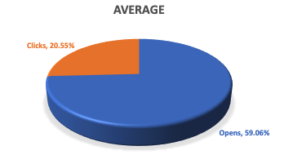

Monday Memo
Notes:
Audience/Distribution 724

Slide 28



TOP performing Content
458 Clicks
301 Clicks
286 Clicks

Slide 29
BOD Election

Slide 30

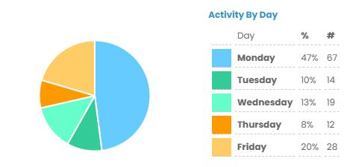

Board of directors election
We reached a final vote turnout of 38%.

Slide 31




Board of directors election
Views 101
Views 255
Views 26
Views 79

