Slide 1




AMANS-NSFM Wellness Committee
Budget and Program Update
Kim Ramsay, CPA, President AMANS
Rebecca Toole, Manager of Professional Development & Education

Slide 2
VISION
Striving for a healthy workplace environment with engaged employees and elected officials.
MISSION
We are committed to supporting and working with Municipalities to ensure they have the resources available to help their employees and elected officials thrive in their wellness journeys and achieve their personal health goals.
Notes:
Strategy Updated 2023
Wellness Programs: Improve employee health, boost productivity, reduce costs, retention, increased engagement, positive culture
Individual determinants: Physical, Mental, Financial, Social
Workplace: Wellness coordinator role, municipal wellness website, evolution of culture in our organizations, i.e working mind for managers and individuals

Slide 3
Governance
Strong governance structure in place with good Committees
AMA-NSFM Wellness Committee
  TOR last approved April 2021
NSFM Health & Benefits Committee
  TOR last approved April 2021
HUB – provides advice to NSFM Health & Benefits Committee, AMA-NSFM Wellness Committee and to individual municipalities.
AMANS Board
NSFM Board
AMANS Staff: Melanie Bower & Rebecca Toole
RECOMMENDATION: That both Committees review the Terms of Reference to clarify governance structure.
Notes:
Roles of Chair need to be clearer
Expectation of Boards needs to be outlined.

Slide 4





Municipal
Wellness
Program
Update
Notes:
Update in package

Slide 5
Upcoming Wellness Activities
Wellness Newsletter (2)
AMANS/NSFM Spring Conferences
Municipal Wellness Grant – 17 applications
The Working Mind – June 17
NS Walks Workplace Walk Leader Training – April 8
Challenges – Active April & Healthy Selfie, Gratitude
Webinars (3) – Self-Compassion for Parents, Chase Worries & Defeat Anxiety
EAP Information Sessions (2) – June 10
Medavie Info Session – June 17
Wellness Champion Network – Meetings
NSFM Road Show - Spring
Municipal Visit
Complete EAP Toolkit and Project Charter
Pilot Workload Management & Burn Out Training April/May/June

Slide 6
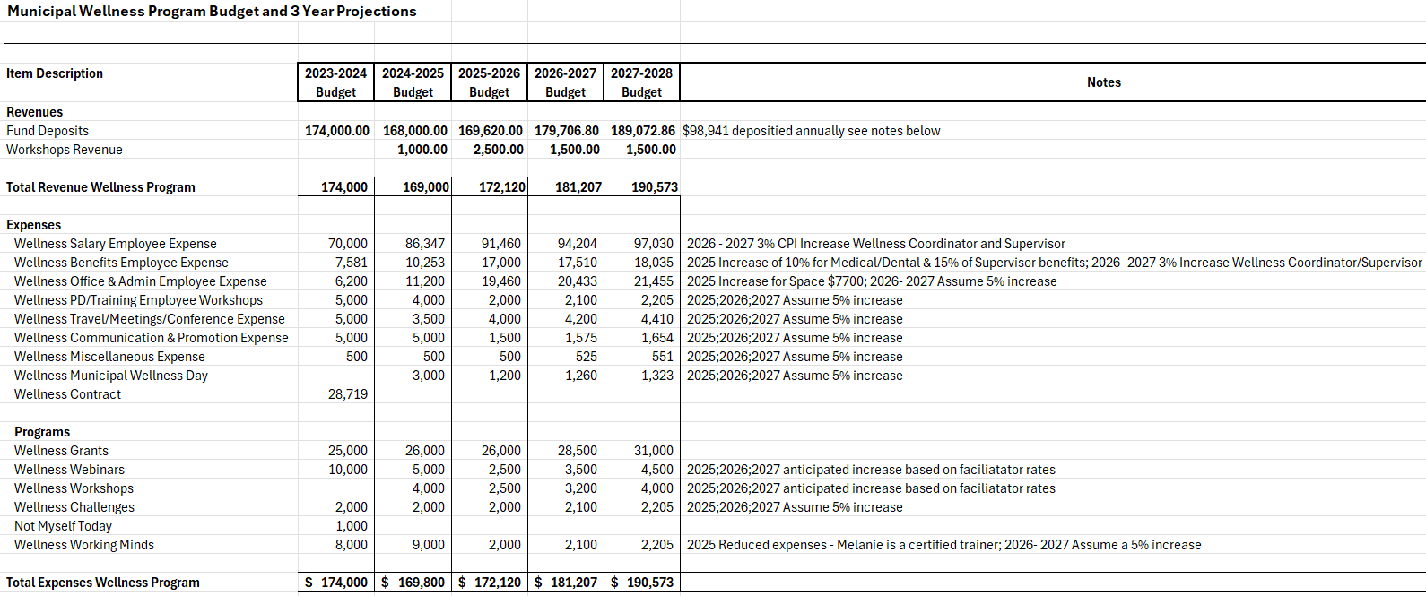
Budget
Notes:
Balance of Reserve is $568K, by 2028 $96K

Slide 7
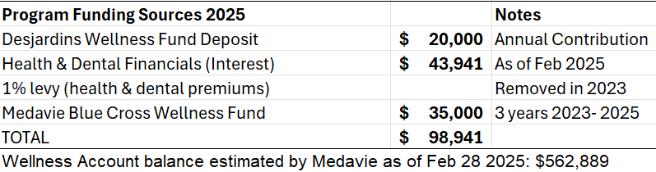
Funding

Slide 8



Recommended Motion
Move that the Board of the NSFM accept the annual report of the Wellness Committee and the proposed budget for 2025-2026 and, that NSFM work with AMANS to review the Wellness Committee Terms of Reference.

